Slide 1

business COMMUNICATION
PCSE
Notes:
NOTE:
To change the image on this slide, select the picture and delete it. Then click the Pictures icon in the placeholder to insert your own image.

Slide 2
BUSINESS WRITING
Business writing includes a wide range of different formats and writing jobs.
These jobs include both internal communication within the company and external communication interfacing with the public and organizations.
Business writing include the development of a newsletters, memos, letters, proposals, reports, power point presentations, press releases, marketing brochures, copywriting, technical writing, web copy, blogging, resumes, job applications, and more.
What is Business Letter?
Is a letter written for formal or professional purposes and should be short, courteous, and to the point.

Slide 3
BUSINESS WRITING
Effective letter language waves:
Conciseness
Informality
Courtesy
Conciseness
Conciseness can be achieved by avoiding wordy expressions and repetition. Using brief and to the point sentences, including relevant material makes the message concise. Achieving conciseness does not mean to loose completeness of message.
b. Informality
To achieve informality, use simple words and sentence structures; personal pronouns like I, me, and your are appropriate. At the same time, don’t go overboard and resort to slang or overly casual expression.

Slide 4
BUSINESS WRITING
c. Courtesy
Courtesy can be achieved by using polite words and gestures, being appreciative, thoughtful, and showing respect to the receiver. Courtesy builds goodwill.
PARTS OF A BUSINESSLETTER
❑Heading
❑Inside Address
❑Salutation
❑Body
❑Complimentary Close

Slide 5
PARTS OF A BUSINESSLETTER
❑Signature
❑Enclosure Notation
The Heading: heading of a letter contains the street address, city, state, and the date.
Inside Address: The inside address consists of the name of the person or of the firm and the address. The address should comprise the street number, the city, and the state.
Salutation: The salutation (or greeting) in a business letter is always formal. Begins with “Dear name}.”Be sure to include the person’s title if you know it (such as Ms., Mrs., Mr., or Dr). And salutation always ends with a colon.

Slide 6
PARTS OF A BUSINESSLETTER
Body: The body is the meat of your letter. Be sure to leave a blank line between each paragraph, however, no matter the line format. Be sure to also skip a between the salutation and the body, as well as the body and the close.
Complimentary Close: A short and polite remark that ends your letter. Capitalize the word of your closing. (Thank you) and leave four lines for a signature between the close and the sender’s name. Comma should follow the closing.
Signature: Skip at least four lines after the close for your signature, and then type out the name to be signed. This often includes a middle initial, although it is not required. And signature should be in blue or black ink.
Enclosure Notation: if you have any enclosed documents, such as a resume, you can indicate this by typing “Enclosures” one line below the listing. You also may include the name of each document.

Slide 7
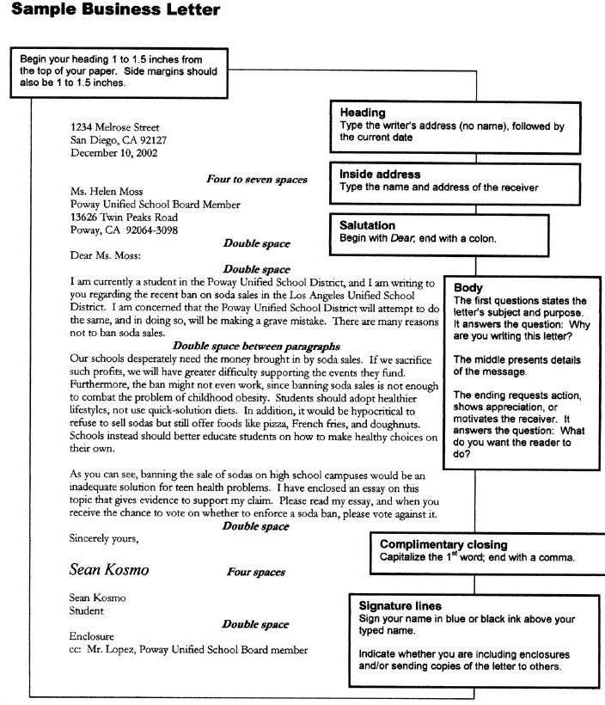
SAMPLE OF A BUSINESS LETTER

Slide 8
Types of Letter

Slide 9
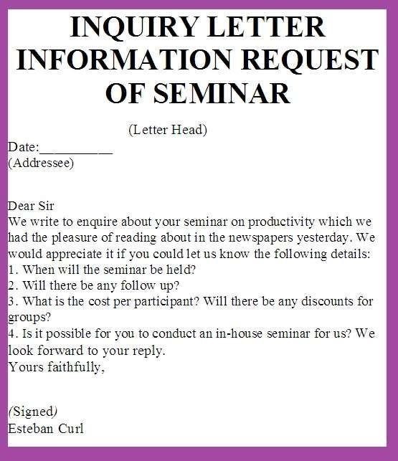
TYPES OF LETTER
❑Letter of Inquiry
❑Order Letter
❑Memorandum
Letter of Inquiry
Written to request information about a given subject.

Slide 10
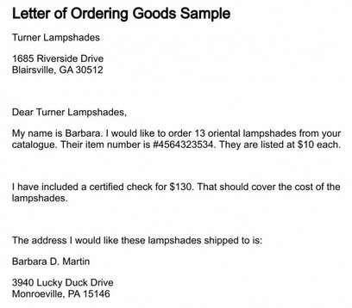
TYPES OF LETTER
Order Letter
Written to request for purchase of goods.

Slide 11
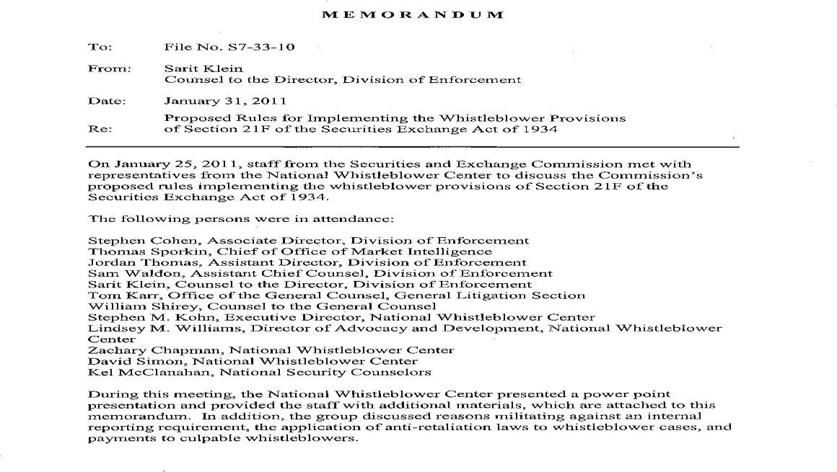
TYPES OF LETTER
Memorandum
Aims to make an announcement, call attention to a meeting, or pass office regulations.

Slide 12
TYPES OF LETTER
Curriculum vitae
A CV is a marketing tool and may be one of the most important documents you write in your professional life.
It is the sum and substance of your work history and education and indicates a particular career direction.
It should demonstrate credibility and be interesting.
What your Curriculum vitae should include
Personal data The only required information is your name, address, phone number, and e-mail address. Be sure to provide both permanent and current address, and the telephone numbers.

Slide 13
TYPES OF LETTER
Career objective An objective tells potential employers the sort of work you are hoping to do. A concise statement indicating your career goals is recommended if you have specific career desires.
Summary of skills/professional expertise A concise statement highlighting your strongest skills and areas of professional expertise can be an advantage to you, especially if you have a mix of experiences in your career history.
Education One rule of thumb is that unless you are more than five years out of school, your education section should precede your experience section. List the names of the institutions you attended with the most recent listed first. List the degree received plus your major area of study.
Work experience Internships and volunteer experience can be considered in this section if they relate to your professional goals, or you can create a section called "Additional or Related Experience," or "Community Service.“

Slide 14
TYPES OF LETTER
Languages If you are fluent or conversant in several languages, list the languages you speak and/or write as follows: "Fluent in French, proficient in Japanese, knowledgeable in Spanish." Think carefully about your level of proficiency. Do not overrate your skills as you may be asked to demonstrate your language ability during an interview.
Interests One or two lines about your outside interests, hobbies, or travels can sometimes add interesting information to the interview and may spark conversation.
References You can write "References Available upon Request" if you have space. Employers will ask directly for references, so prepare a list with names, titles, addresses, and telephone/fax numbers. Ask people if they are willing to serve as references before you give their names to a potential employer.

Slide 15
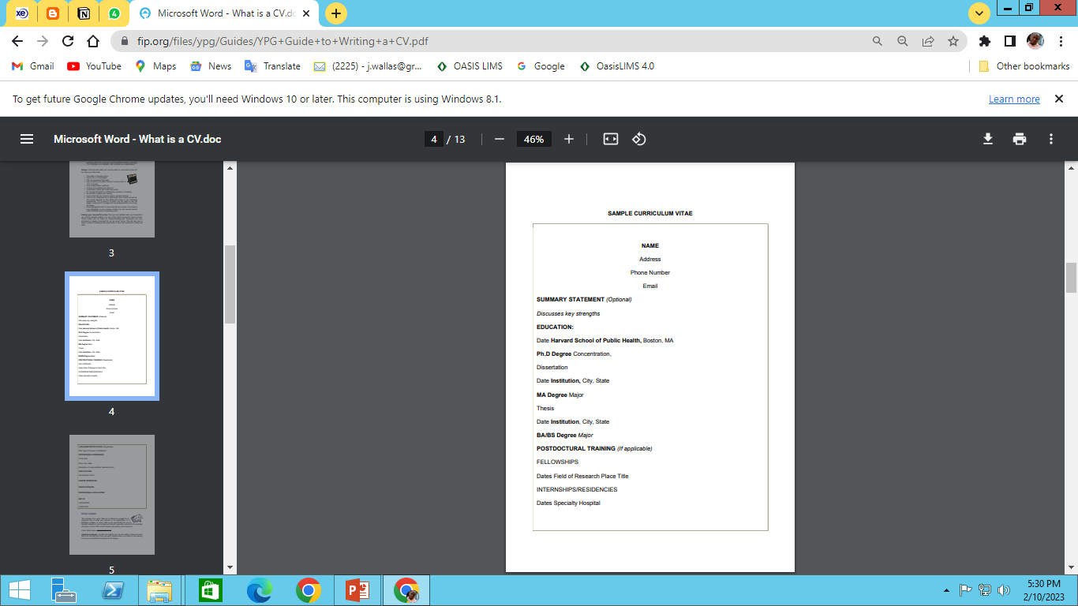
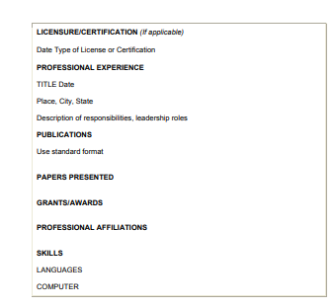
TYPES OF LETTER

Slide 16
THANKS FOR YOUR TIME

